Slide 1

SQL Project Music Store

Slide 2


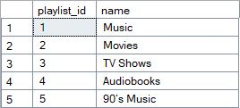

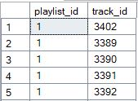
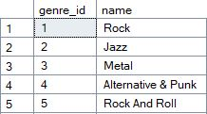
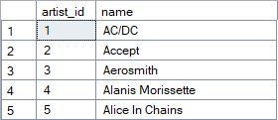



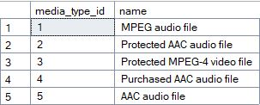
Tables

Slide 3

Find the most senior employee based on job title.

Slide 4


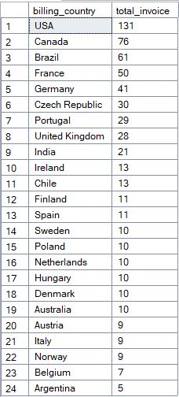
Determine which countries have the most invoices.

Slide 5


Identify the top 3 invoice totals.

Slide 6


Find the city with the highest total invoice amount to determine the best location for a promotional event.

Slide 7



Identify the customer who has spent the most money.

Slide 8

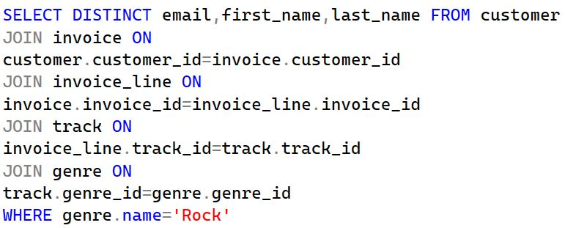
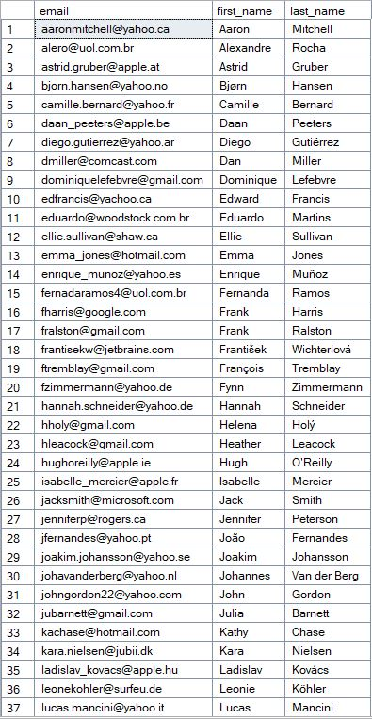
Find the email, first name, and last name of customers who listen to Rock music.

Slide 9


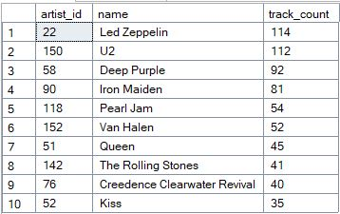
Identify the top 10 rock artists based on track count.

Slide 10

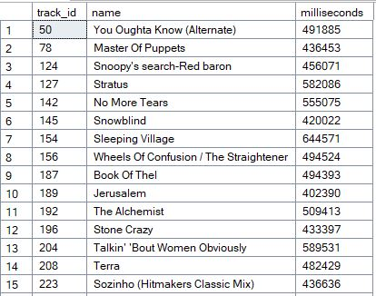
Find all track names that are longer than the average track length.

Slide 11

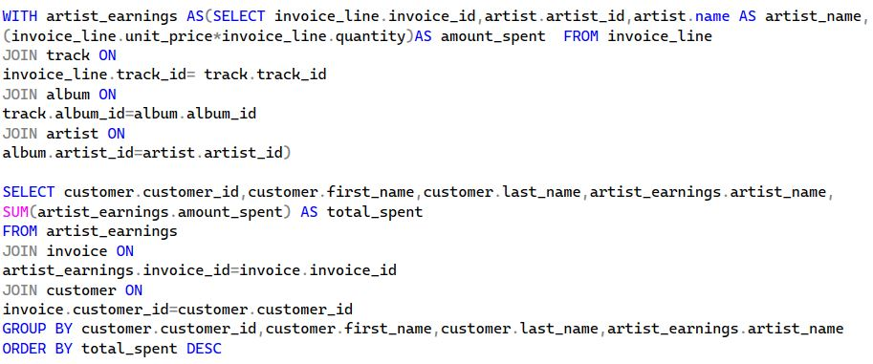
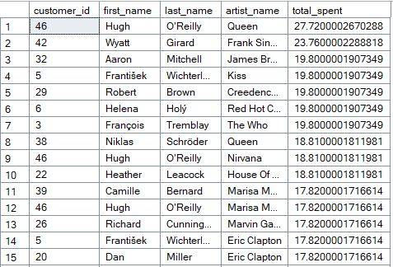
Calculate how much each customer has spent on each artist.

Slide 12

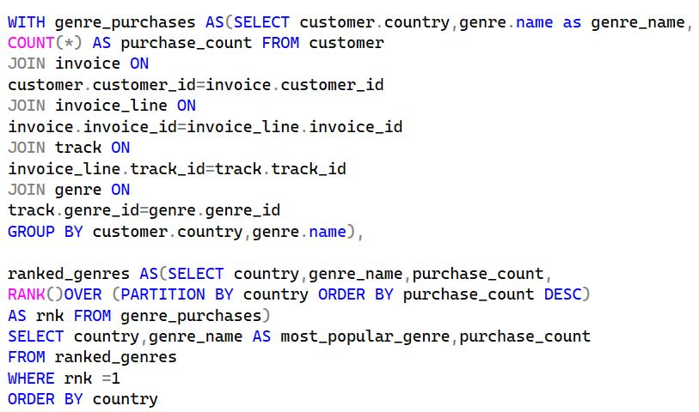
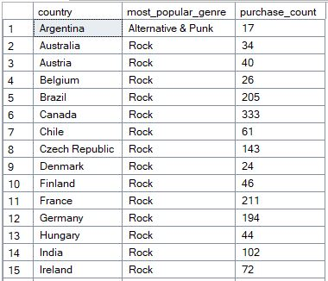
Determine the most popular music genre for each country based on purchases.

Slide 13


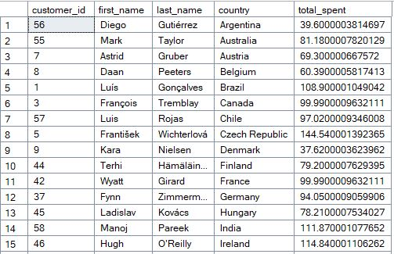
Identify the top-spending customer for each country

